Slide 1

3D Animation:
Why it’s Better
By: Corey McPherson

Slide 2
The Problem
Live-Action media has become a crutch for cinematic experiences through the adaptation of comics, novels, book, etc.
Oftentimes, viewers are stuck with contract actors with subpar performances for their beloved characters in adaptations.
Live-Action is heavily bound by the constraints of reality.
Many different forms of conflict can arise during the role of a character in cinema.

Slide 3

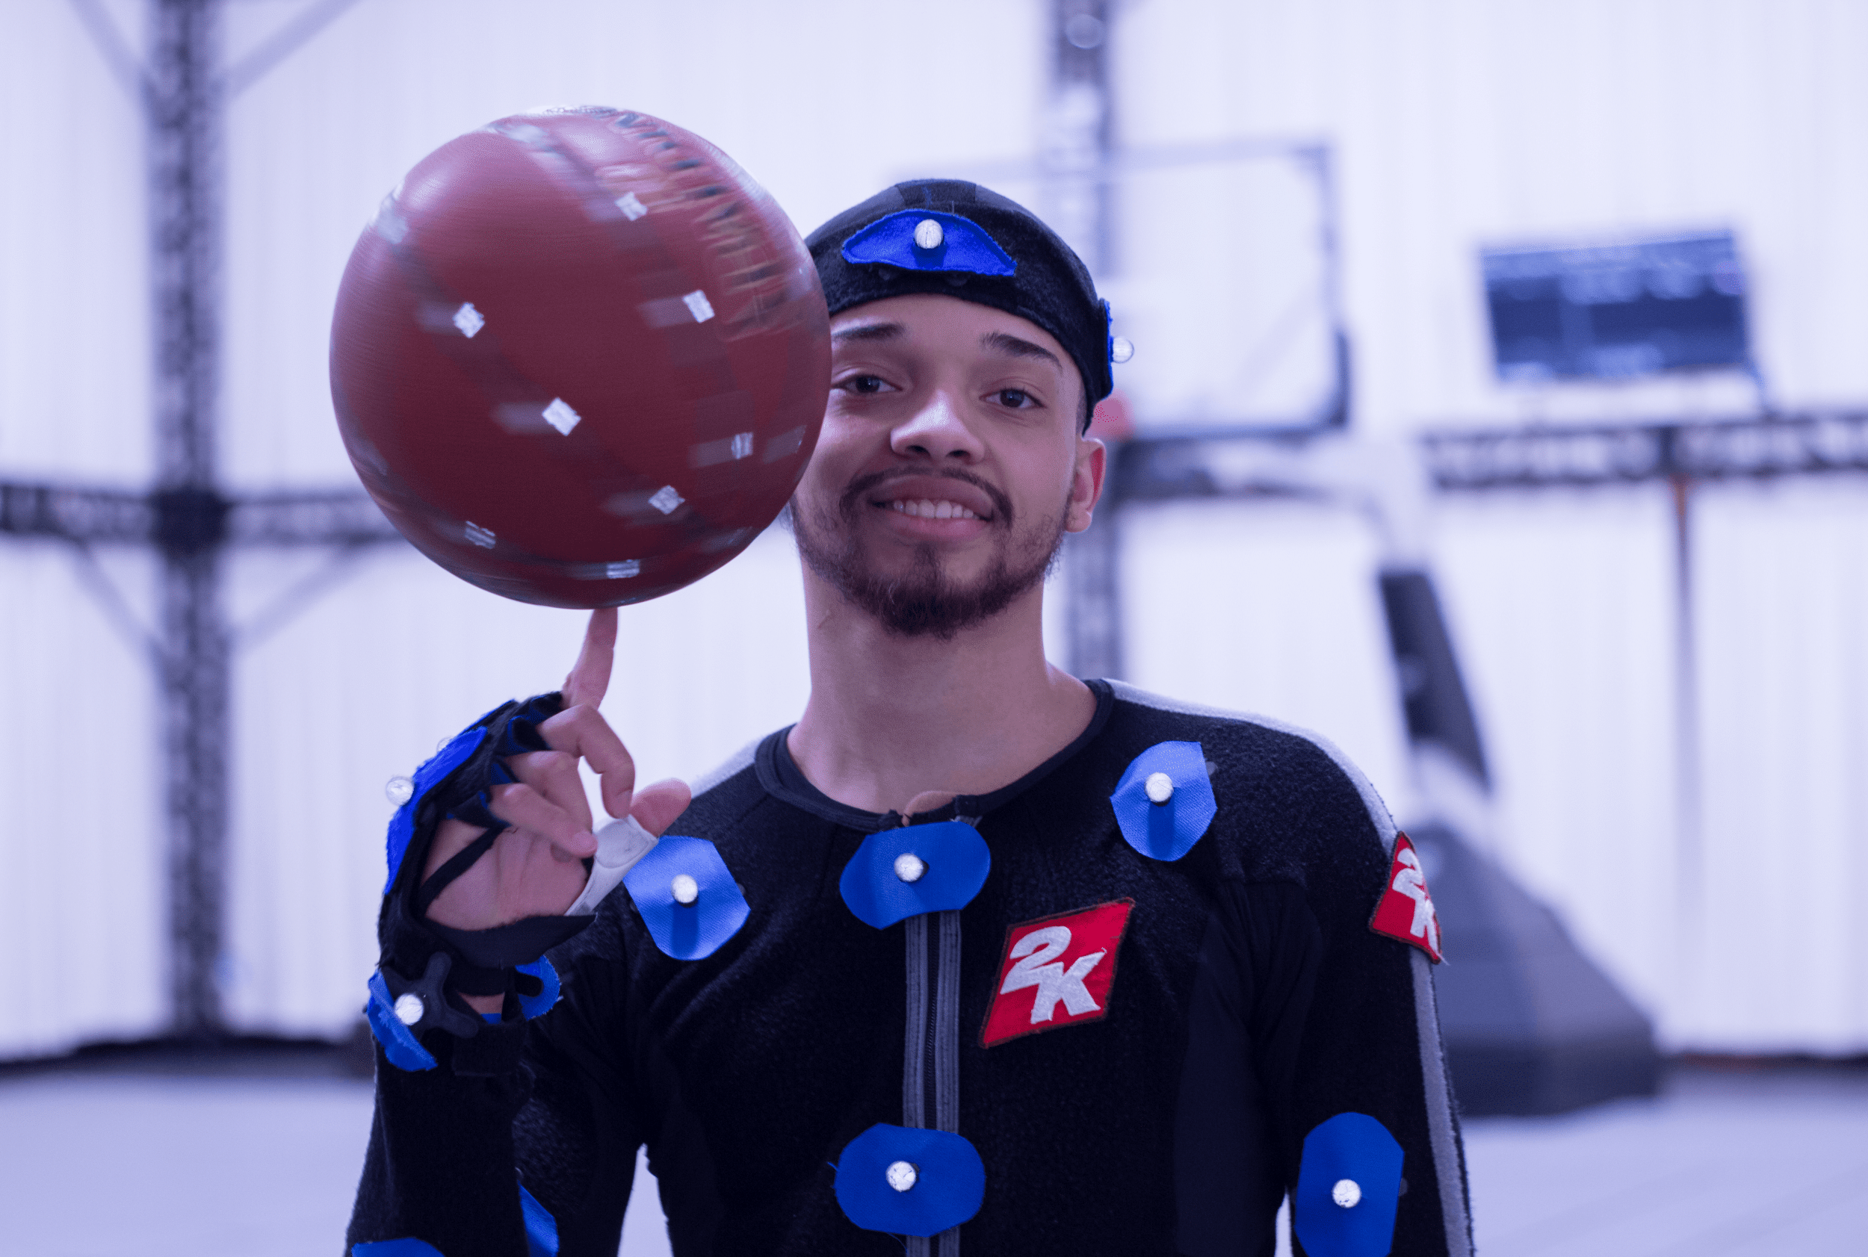
Animation is Simply Better
Animation allows for the creation of entirely new worlds, characters, and scenarios that are not bound by the constraints of reality. This freedom enables filmmakers to explore fantastical and imaginative storytelling that would be challenging in live-action.

Slide 4


If it can be done live, it can be animated better.
Time and cost
Choreography
Acting
Actor Consistency
Timelessness

Slide 5


“No it’s not! What about [insert your favorite live-action movie]?”
I am not arguing that live-action cinema is pointless, rather I am offering the imagination to think “what if?”

Slide 6

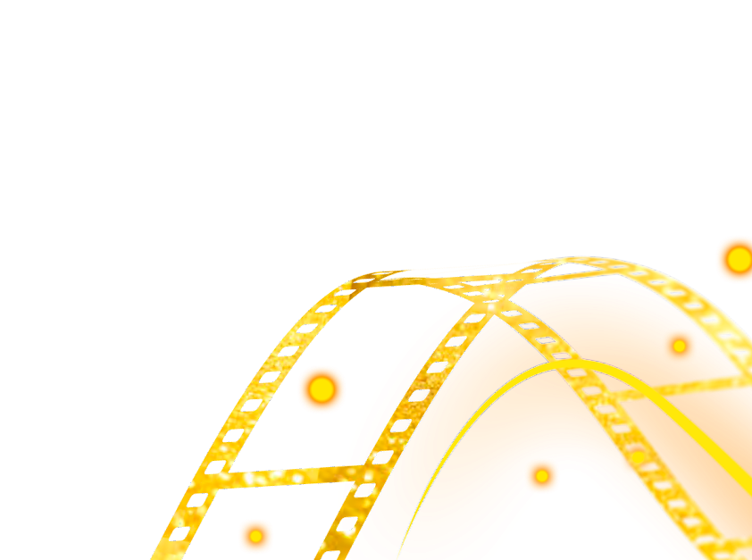
Live action media for fantasy, specifically ones based from novels, comics, or books, have continually been adapted into live-action cinema.
Marvel and DC Universe
Harry Potter, Hunger Games, Percy Jackson, etc.
While these are good examples of adaptation, this is not always the case.
In the case of novels, where there is no base material image to start from, directors are forced to draw from their creativity. However, in the case where the source material is one with images, especially depicting the characters in extraordinary situations, the medium of adaptation should be equally as extraordinary.
There also seems to be more complaints for live performances than there are for animated ones.

Slide 7
—W.R. Irwin
“[Fantasy] allows us to enter a world of ‘contrasts and opposites’, to break away from the entrapment of realism.”

Slide 8
Link 1 - The Medium
https://dalspace.library.dal.ca/bitstream/handle/10222/78589/YAhotline_76_17.pdf?sequence=1#:~:text=Fantasy%20literature%20offers%20the%20reader,from%20the%20entrapment%20of%20realism.
https://www.enterpriseappstoday.com/stats/film-industry-statistics.html#:~:text=globe%20is%2026.5%25.-,The%20annual%20revenue%20of%20the%20global%20film%20industry%20as%20of,stated%20by%20film%20industry%20statistics.

